Slide 1
RAKE PLANNING PROBLEM
Presented by Tuhinangshu Majumder

Slide 2
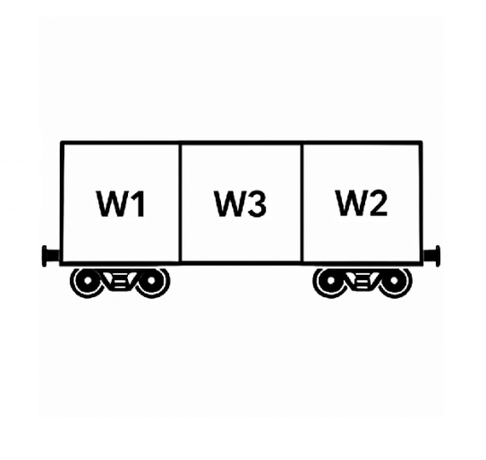
INTRODUCTION
This project focuses on developing a heuristic-based solution for assigning steel coils to railway wagons in compliance with RDSO safety guidelines. The aim is to ensure safe, balanced loading across wagon zones (W1, W2, W3) while satisfying constraints on weight, dimensions, and placement rules. A secondary machine learning model is also explored to assist in zone prediction.

Slide 3
PROBLEM STATEMENT
Efficient and safe loading of steel coils into railway wagons is critical in the steel industry. Manual planning often fails to meet complex RDSO constraints such as zone-wise coil limits, weight balancing, and special loading conditions. This project addresses the need for an automated, rule-based system to assign coils to wagon zones while ensuring safety and regulatory compliance.

Slide 4
Constraints: rdso guidelines
Maximum 6 coils per zone (W1 or W2)
W3 zone rules:
Max 1 coil in W3
Coil weight in W3 ≤ 21 MT (±1 MT)
W3 load must not exceed W1 or W2
Zone-specific weight limits depend on wagon type (e.g., BOXN: W1/W2 limit = 35T)
Special loading rule:
If DbyW > 1.5 and 600 mm < Width < 1200 mm, the coil must be placed with vertical eye or in a v-groove
For multiple coils in a zone:
Width difference between adjacent coils ≤ 300 mm
Heavier coil weight ≤ 2.25× lighter coil

Slide 5
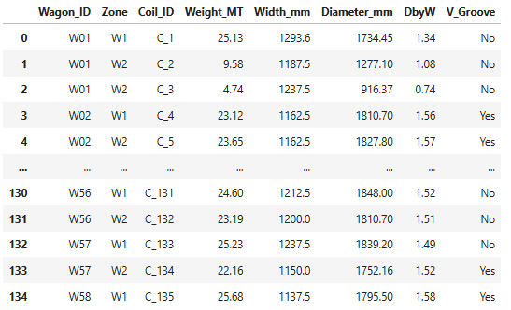
ALGORITHM​
FINAL DATAFRAME
The heuristic algorithm allocates steel coils to wagon zones (W1, W2, W3) using rule-based checks based on RDSO constraints. It considers coil weight, dimensions, zone capacity, and compatibility. W1 and W2 are prioritized, while W3 is used only when needed. The approach ensures safe, simple, and regulation-compliant loading without relying on complex optimization.

Slide 6
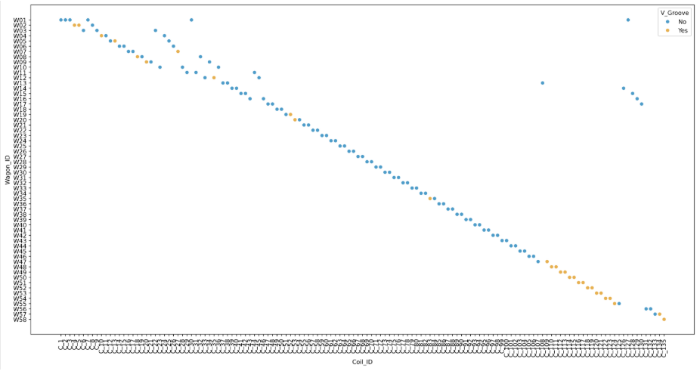
IMPLEMENTATION
The heuristic algorithm in Python assigns coils to wagon zones based on RDSO rules. Coils are first attempted in W1 or W2 if within weight and compatibility limits (coil count, width, and weight ratio). If not feasible, W3 is used with stricter constraints. Coils needing vertical placement are flagged using the DbyW and width criteria. Final assignments are stored and exported for analysis.
WAGONS vs COILS

Slide 7
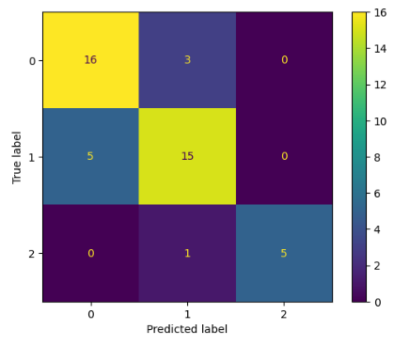
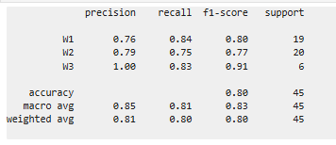
WAGON PREDICTION MODEL
A Random Forest model was developed as a supplementary tool to predict the appropriate wagon zone for each coil based on features like weight, width, diameter, DbyW, and v-groove requirement. The data was one-hot encoded, merged with heuristic assignments, and balanced using SMOTE. While the model achieved around 83% accuracy, it remains experimental and not yet reliable enough to replace the rule-based heuristic.

Slide 8
THANK YOU

